Slide 1
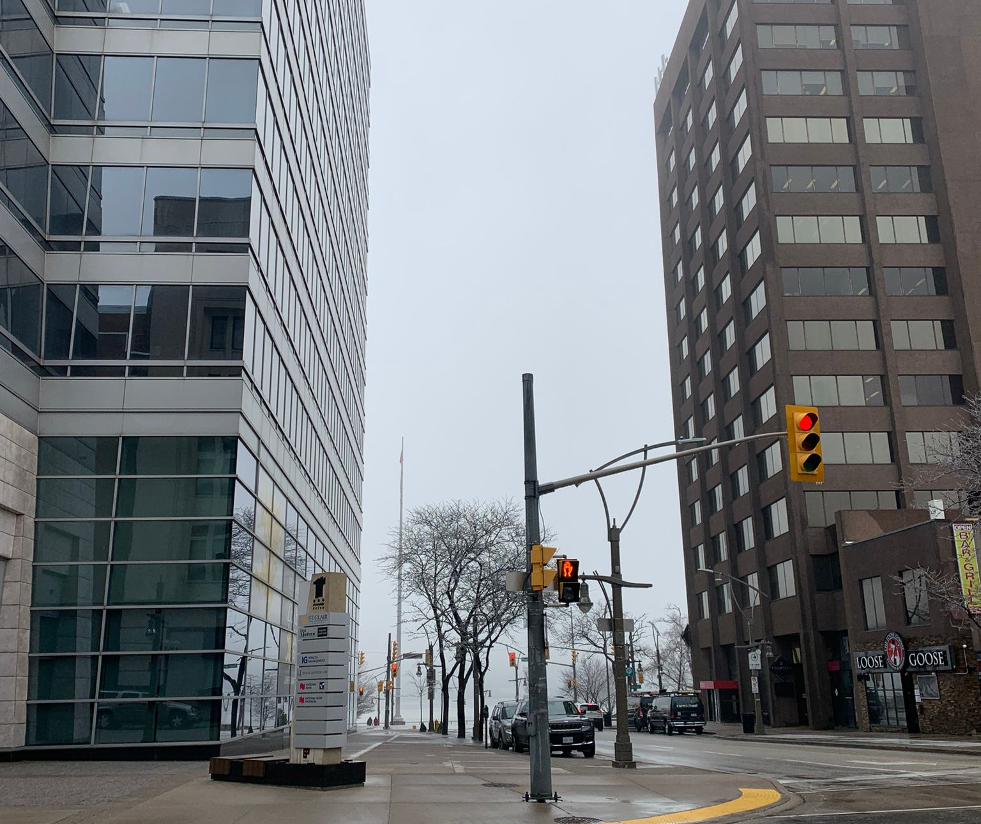
Climate Change in Windsor Region
DAB103 – Analytical Tools & Decision Making
Group Number : 01
Section : 002

Slide 2



Meet the Team
Pearlin Pereira
Shraddhaba Jadeja
Roshan Khan

Slide 3

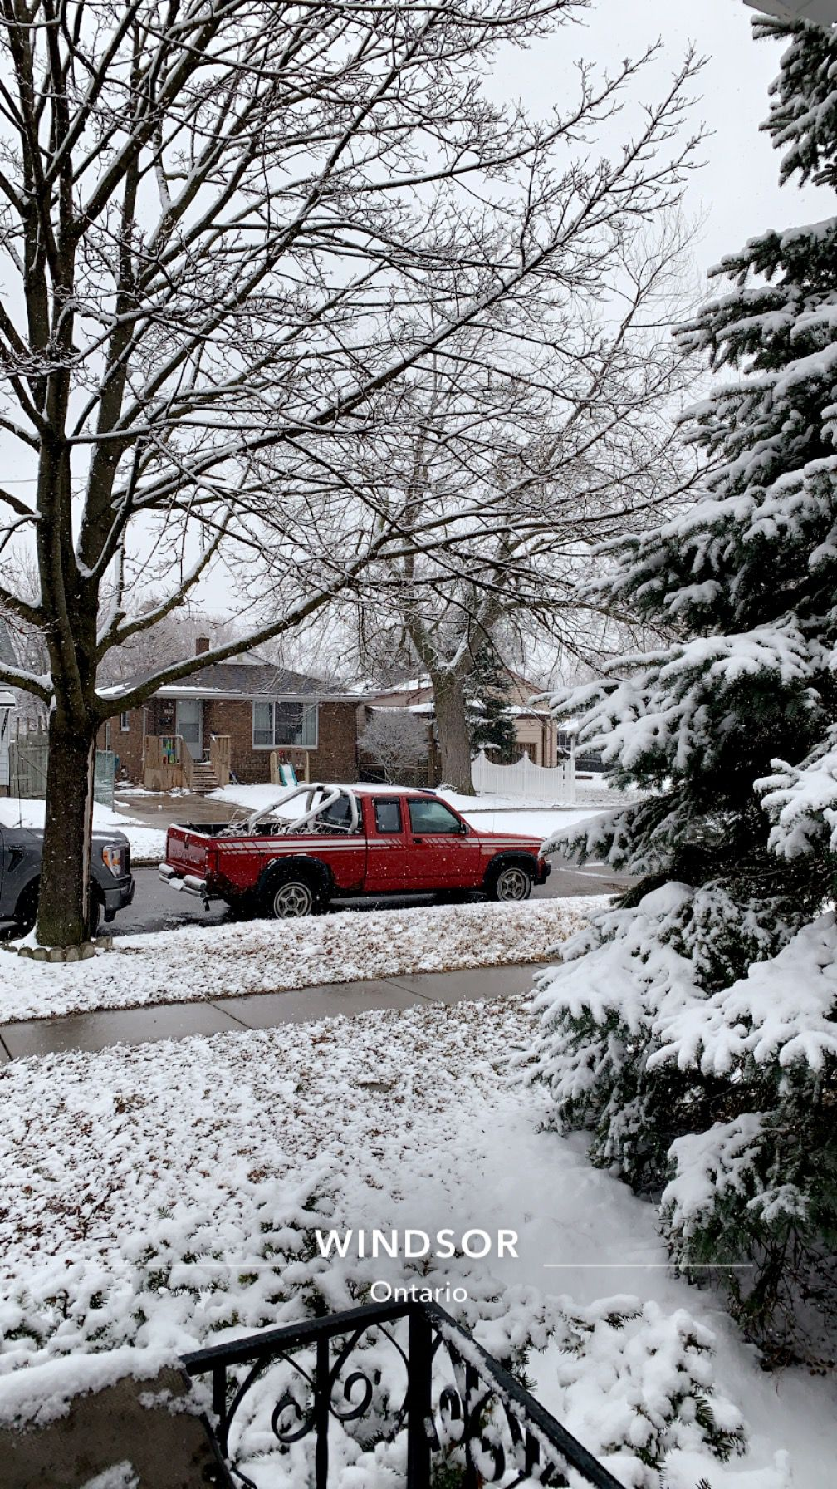
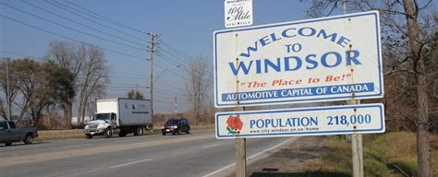
Agenda
Background and Motivation
Problem Statement
Project Proposal
Analysis Questions
Dataset
Questions for Analysis
Conclusion
Recommendations
Exploratory Data Analysis
Data Cleaning
Data Transformation
Data Visualization
References

Slide 4
Background and Motivation
Climate change is a global challenge that is affecting many parts across the world, including the Windsor region in Canada.
The mild winter and lack of expected snowfall have raised concerns among agricultural businesses and other major sectors in the region, highlighting the need to understand the underlying reasons behind these extreme climatic conditions.
By identifying the factors contributing to these changes, agricultural businesses can develop effective strategies to mitigate and adapt to the impacts of climate change, ensuring their continued success and sustainability.

Slide 5
Problem Statement
The Windsor region is facing the challenge of extreme climate and weather events, including high-speed winds, snowstorms, and shifting temperature patterns, particularly in the winter.
These changes have significant implications for the agricultural community, including the health and well-being of crops and livestock, as well as the region's economy and natural resources.
This project aims to help agricultural businesses understand the underlying reasons behind these extreme climatic conditions and identify strategies to mitigate and adapt to their impacts.

Slide 6
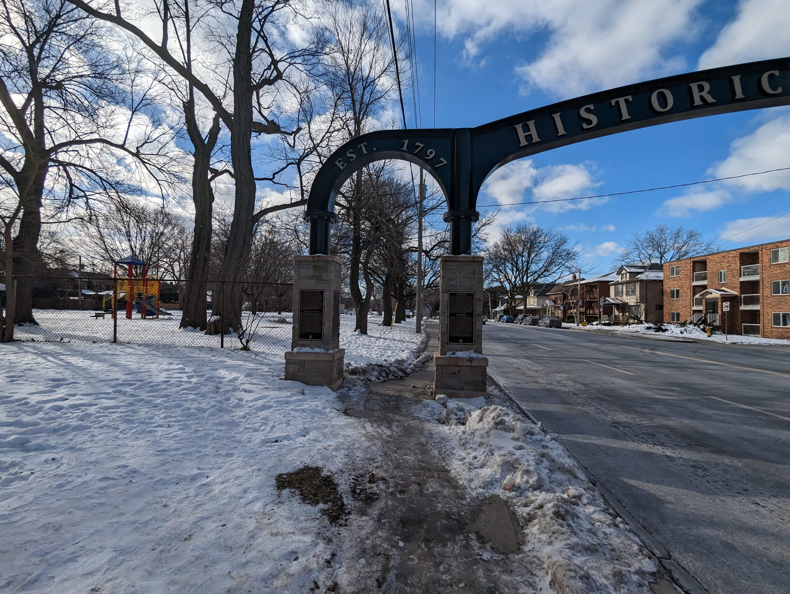
Project Proposal
This project aims to identify the reasons behind extreme weather events, particularly the mild winter and unexpected snowfall patterns, and mitigate their impact on the agricultural sector in the Windsor region.
By addressing the issue of climate change in the Windsor region, the project can help to ensure the long-term sustainability and success of agricultural businesses, as well as protect the health and well-being of the community and preserve the region's natural resources which will help the government to take precautionary steps for the upcoming years.

Slide 7
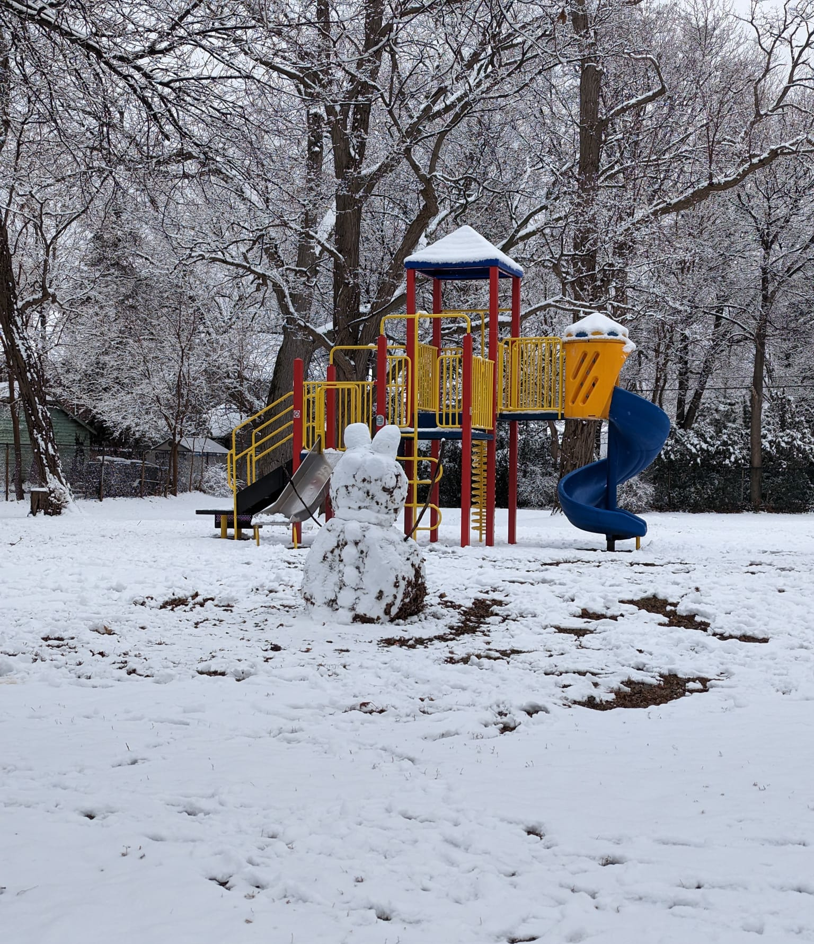
Analysis Questions
How was the average temperature in Windsor region changed over the past century? Is there a clear trend?
How have extreme precipitation events (measured by total precipitation) in Windsor changed over time?
How has the mean temperature in Windsor region changed over the months with respect to the years, and what are the seasonal patterns in temperature?
How has the amount of snow in Windsor varied over the years ?
How has maximum wind gust speed in Windsor varied with the mean temperature from the last 5 years?

Slide 8
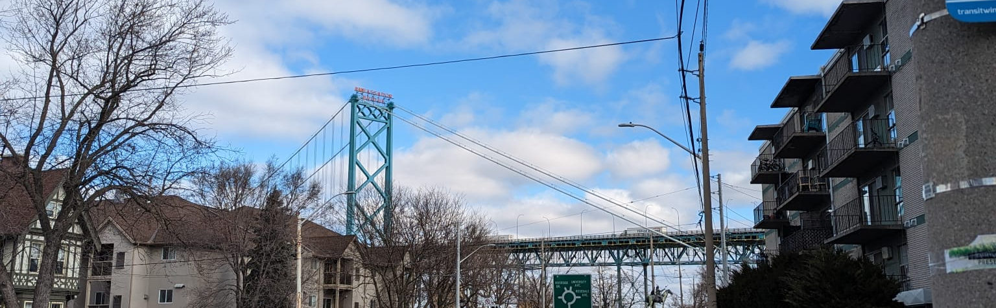

Dataset
It describes historical climate data for various locations across Canada, including Windsor.
The dataset includes information on temperature, precipitation, wind speed, Total snow and other key climate elements in the Windsor region over a decade.

Slide 9
Snow on ground, total precip
Target variable
Total Rain
Climate Change over the past decade in Windsor Region
Station names, months
Unique variable
Categorical variable
Max temp, Min temp, Heat deg days, cool deg days, total snow
Numerical Variable

Slide 10
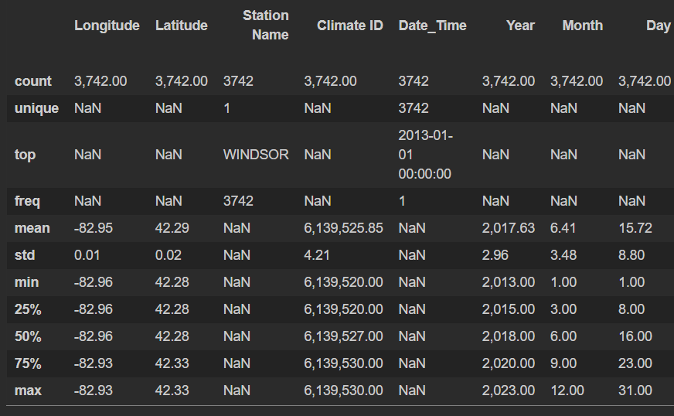
Data Cleaning
We took several steps to ensure that our data was cleaned and ready for analysis.
Initially, we assessed the number of null values present in the dataset.
Then, we removed any superfluous columns that were not necessary for analysis.
Subsequently, we identified the remaining column names and analyzed the distinct values within the essential columns.
Furthermore, we verified that there were no negative values in the columns where negativity was irrelevant.
Lastly, we examined the dataset for any duplicated records.

Slide 11
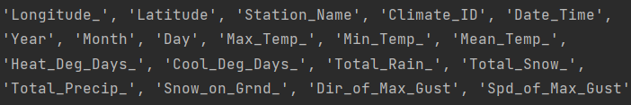
Data Transformation
We have transformed white spaces ( ) to hyphens (-) in the column names.
Makes it easier for the user to code easily.

Slide 12

Questions for Analysis
VIA
Visualization

Slide 13
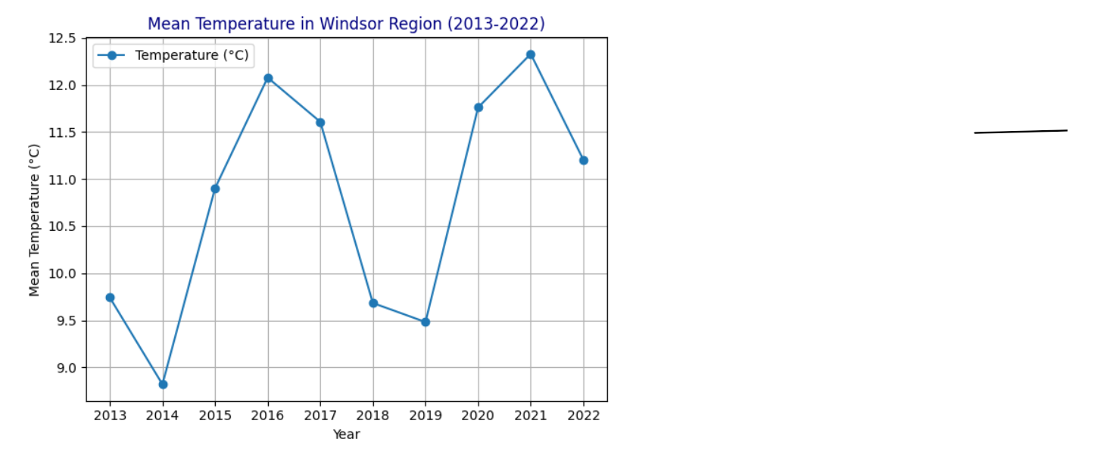
How has the mean temperature in Windsor region changed over the past decade? Is there a clear trend?
The line graph aids in analyzing the mean temperature trend from 2013 to 2022. The average temperature in the Windsor region has risen over the last decade, as illustrated.

Slide 14
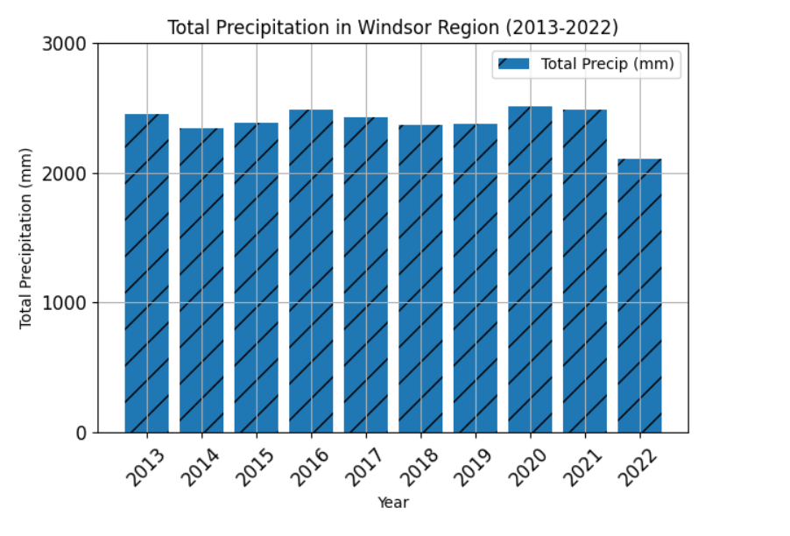
How have extreme precipitation events (measured by total precipitation) in Windsor region changed over time, and what impact could this have on agriculture?
Extreme precipitation events have a significant impact on agriculture. This bar graph shows the shows the total precipitation measured in millimeters in the past century.

Slide 15
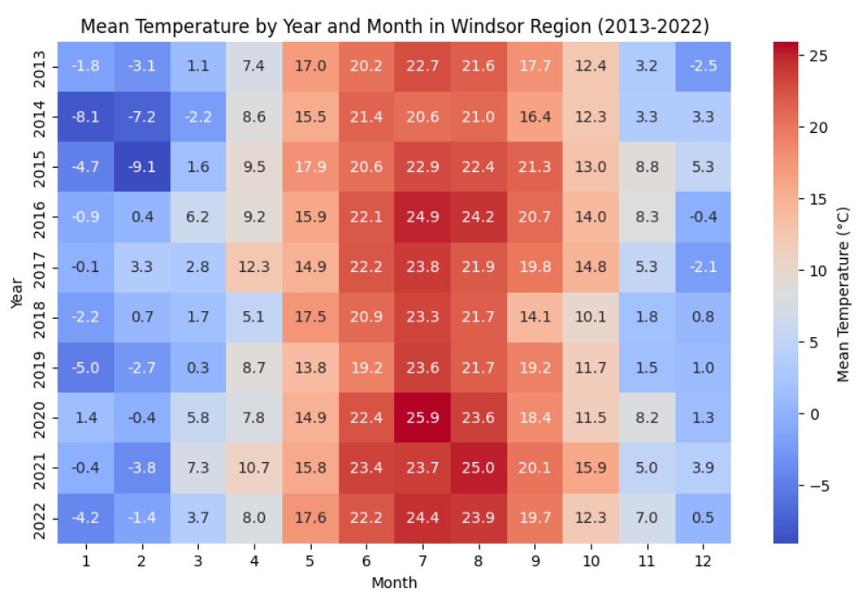
What are the seasonal temperature trends, and how have they changed over time?
The heatmap depicts the seasonal patterns year and month wise over the last decade.
Understanding the seasonal patterns in temperature is important for agricultural planning, as it helps farmers decide what crops to plant and when to plant them.

Slide 16
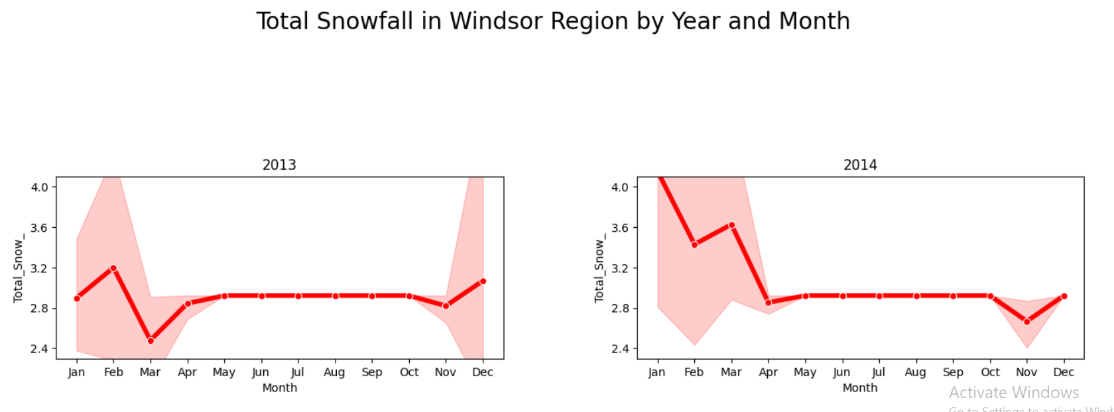
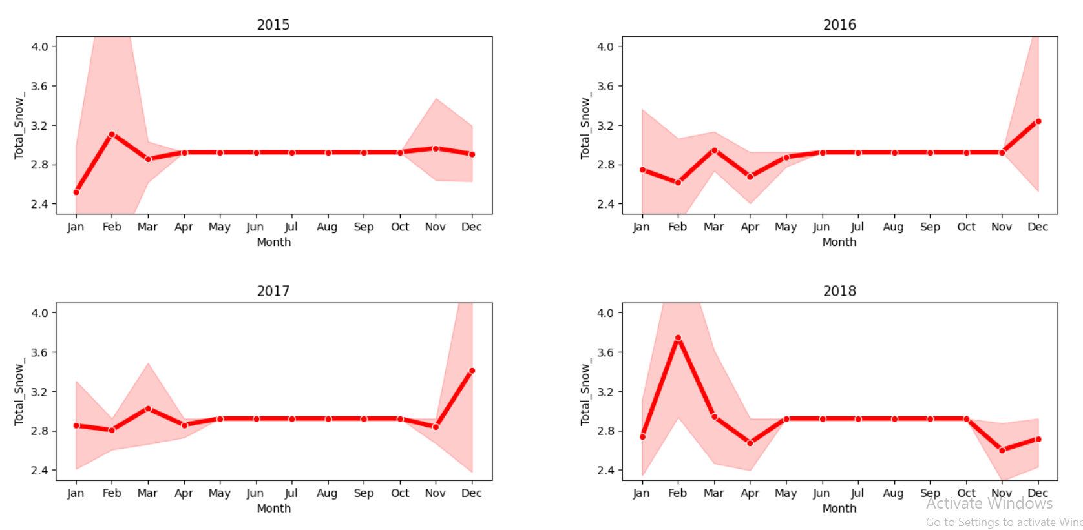
How has the amount of snow
in Windsor region varied over the years?

Slide 17
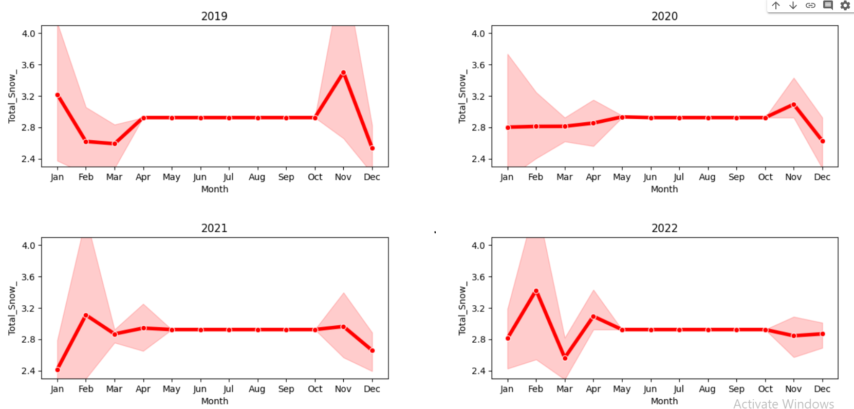
The time series graphic above depicts the fluctuations in snowfall in the Windsor region from 2013 through 2022. We can see that the amount of snowfall in the Windsor region has changed throughout time, with some years receiving relatively little snow and others receiving significantly more.

Slide 18
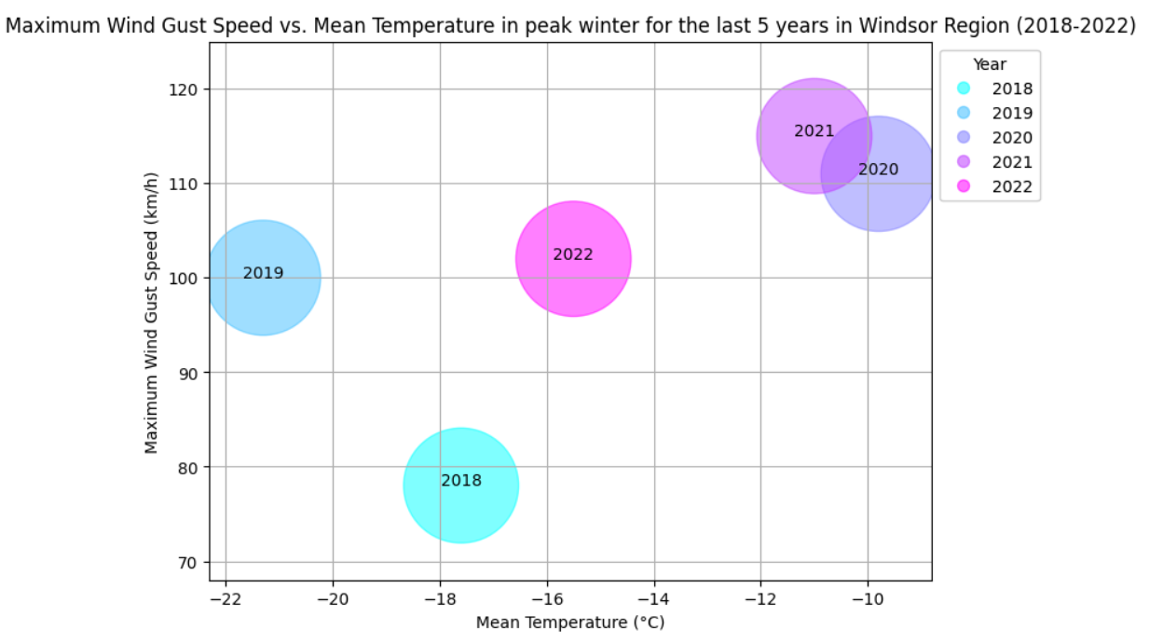
How has the maximum wind gust speed during peak winter (December-February) in Windsor region varied with mean temperature from the last 5 years?
The bubble chart depicts some high maximum wind gust speeds in kilometer per hour recorded in years with both high and low mean temperatures.

Slide 19
Conclusion
The average temperature in the Windsor region reaches its highest point every 5 years.
Total precipitation has decreased significantly in 2022 as compared to the average of previous years.
We can detect strong seasonal patterns in temperature, with the summer months getting substantially warmer over time while the winters elevate colder and colder each year.
Based on previous years, 2016 was projected to have a similar snowfall pattern, however there was a major decline in the pattern. The same trend happened the next year as well, then it returned to normal snowfall pattern in 2018.
According to our analysis of the last 5 years with both high and low mean temperatures, maximum gust speeds have been continuously increasing. However, every two years has been a significant jump.

Slide 20
Recommendations
Following our examination of how the analysis could benefit the agricultural sector, we have made the following recommendations:
Implement adaptation strategies for agricultural businesses, such as adjusting planting schedules, crop choices, and irrigation methods.
Encourage the use of drought-resistant and climate-resilient crop varieties to maintain yields under changing climatic conditions.
Invest in infrastructure to mitigate the effects of extreme precipitation events, such as improved drainage systems and erosion control measures.
Strengthen early warning systems to better anticipate and prepare for extreme weather events, minimizing potential damage to agriculture.
Support research and development of innovative farming practices that promote sustainability and resilience to climate change.
Advocate for policies that address the root causes of climate change, promoting a more sustainable future for the Windsor region's agricultural sector.

Slide 21






GitHub
Drive
JIRA

Slide 22
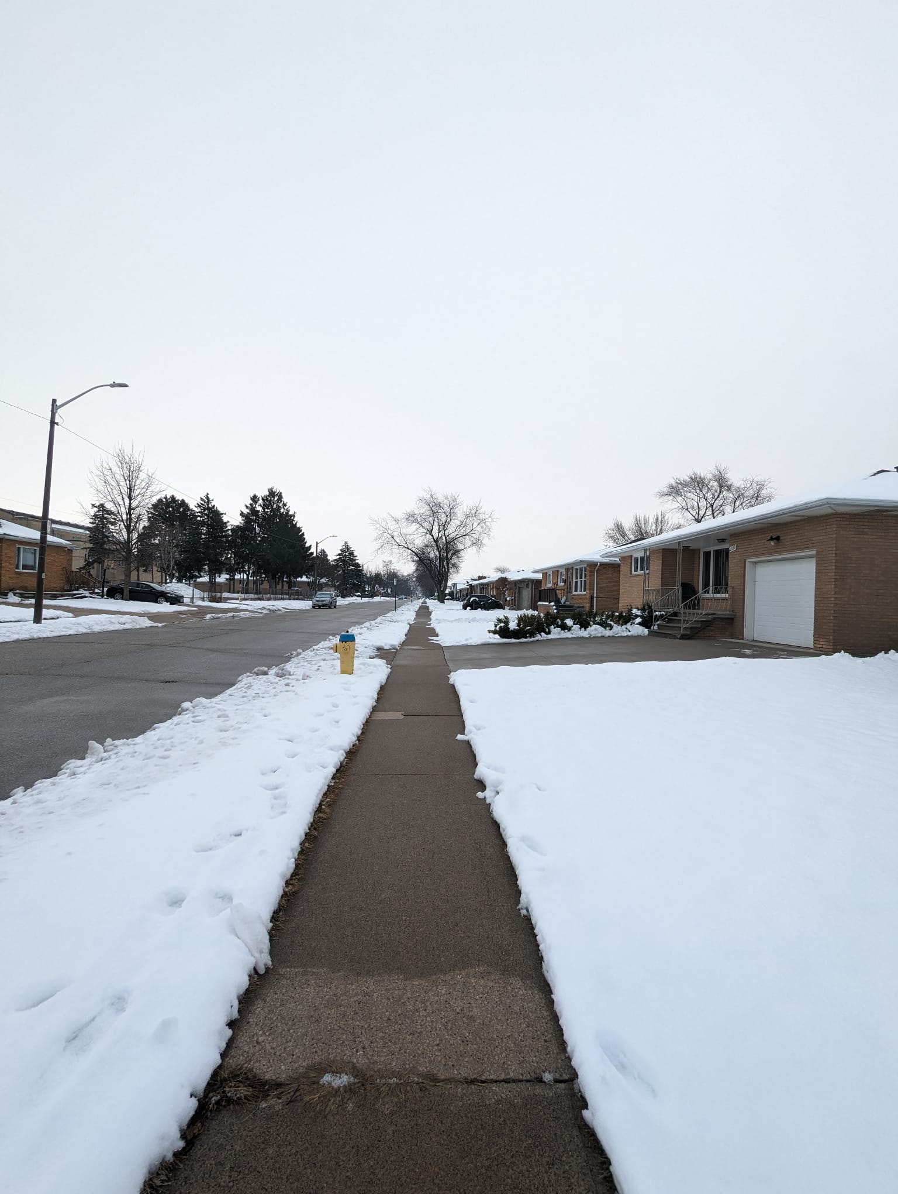
References
The official website of the Government of Canada: https://www.canada.ca/en/services/environment/weather/climatechange.html
Public Safety Canada, Canadian Disasters Database, Retrieved online: https://www.publicsafety.gc.ca/cnt/rsrcs/cndn-dsstr-dtbs/index-en.aspx
The Windsor-Essex County Health unit: https://www.wechu.org/climate-change
Github Repository on Climate Data and Analysis Section Environment and Climate Change Canada by author rodneychan-ec : https://github.com/ECCC-CDAS/RClimDex
JIRA Software: https://pearlinpereira.atlassian.net/jira/software/projects/CCIWR/boards/1
Github : https://github.com/Pearl0111/Climate-Change-in-Windsor-Region

Slide 23

Thank You

